Slide 1


Harness the Power of your Operating Budget to Enhance your Learning Environment
MASBO Winer Conference – Jackson, MS

Slide 2
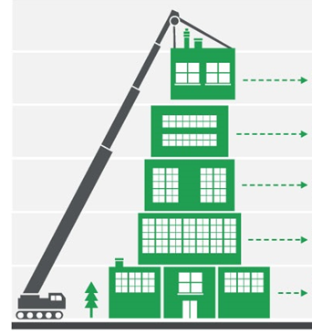

Why Are We Here?
Budgetary pressures from lack of education funding
Rising utility and maintenance costs
Rising interest rates
Aging facilities
School districts must find a way to address pressing facility needs, without dipping into their fund balance or growing debt obligations

Slide 3
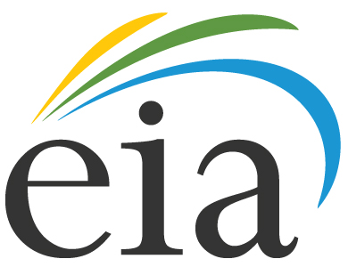
Rising Utility Costs: How does this Impact your District?
If your electricity Budget was $250,000 in 2006…
Your budget for 2017 will be $320,854
An increase of $70,854, or 28.34%
Outdated lighting, HVAC and building automation could be responsible for increasing a district’s budget by 10 – 40%

Slide 4
Areas of Waste / Opportunities for Cost Savings
Energy:
  Lighting
  HVAC
  Plumbing fixtures
IT
  Phone
  Internet
Operations
  Service agreements
  Premature failure of equipment
  Remedies to humidity, moisture, leaks
Most pressing, unfunded maintenance needs:
  HVAC renewal
  Roof replacement
  Windows
  Electrical renovation
  IT infrastructure
  Sports lighting
  Energy and operational efficiency upgrades

Slide 5
Strategies for Implementing Efficiency Projects
Delivery Methods | Cost | Expertise & Time of Staff Needed | Magnitude of Work | Magnitude of Impact | Investment Risk
In-house design / installation | Low | High | Low | Low | Moderate
Design - Bid- Build | High | Low | High | Moderate | Moderate
Energy Performance Contract | Low - None | Low | High | High | Low
Behavioral Approach | None | Moderate | None | Moderate | Moderate

Slide 6
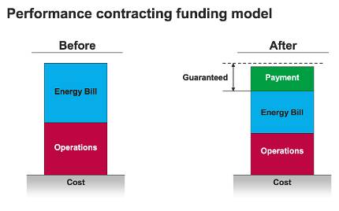
Energy Performance Contracting
Create a revenue stream: Reinvest 15-30% of energy & operational costs into needed infrastructure improvements
One Partner: Energy audit, design, implementation, fund sourcing & performance guarantee
Long-Term Guarantee: Annual savings are guaranteed for a term of up to 20 years. In the occurrence of a savings shortfall, the ESCO covers the difference.
Enabling Legislation
Public Contracts for Energy Efficiency Services
MS Code 31-7-14
Annual guaranteed savings

Slide 7


Funding Opportunities
Utility Rebates: Great rebate programs from Mississippi utility providers
MDA Energy Efficiency Lease Program: Finance energy efficiency projects for a term of up to 20 years with no impact to bond capacity.
Energy Performance Contracting: Leverage guaranteed energy and operational savings to secure financing for a term of up to 20 years with no upfront cost.
Traditional Sources: Bond issue, QZAB, loans, cash, etc.
We helped Holly Springs SD, Marshall County SD & the City of Tupelo each get about $100K in rebates through the TVA EnergyRight Program

Slide 8
Funding Equation for
Biloxi Public Schools
$1.6M
Baseline electricity, gas & water budget
$244,000
Annual Guaranteed Savings
$4.5 Million
Total guaranteed savings over 15 year partnership
15% savings
* Assume 3% annual utility rate escalation
$3 Million - Comprehensive Solution
HVAC renovations
District-wide Lighting retrofits
District-wide Building Automation
Retro-Commissioning existing Building Automation
Plumbing retrofits to conserve water
0.8% Qualified School Construction Bond
$740K SEP Performance Contracting Grant from MDA
No upfront or out-of-pocket – Over $1M in positive cash flow!

Slide 9
Biloxi Public Schools – Phase 1
Savings to Date
Guarantee through July 2016: $1,297,096
Reconciled Savings through July 2106: $1,750,497
Savings have exceeded the guarantee by over $450K! Phase 2 is being implemented now, and will increase annual savings by an additional $120K!

Slide 10
Leveraging Savings & Energy Financing to do Major Renovations
Yazoo County Schools, MS
$92,777
Annual Guaranteed Savings (24% reduction)
$2.5 Million
Total Guaranteed Savings over 20 year partnership
$4.2 Million
Project Value
Bottom-Line
The district received over $4M in upgrades for less than $2M out-of-pocket
Scope of Work
Replaced air-cooled chiller system at High School with VRF heating/cooling system
Installed drop ceilings to reduce conditioned space
Added exterior lighting for campus safety and security
District-wide plumbing upgrades
District-wide interior lighting renovation
District-wide building automation to control HVAC and energy usage
IT enterprise management system to save energy across all network devices

Slide 11
The Bottom-Line
If you… have a burden of deferred maintenance and critical facility needs and a lack of sufficient funding
If you… need to resolve a complex issue or to complete a comprehensive renovation
If you… want to generate deep savings from your energy budget without depleting your capital improvement budget or bond capacity
If you… need a savings guarantee to substantiate investments in facilities and energy efficiency
You may want to consider an Energy
Savings Performance Contract to address your goals!

Slide 12
QUESTIONS

